Slide 1
Bangladesh Army University of Science and Technology
Department of Computer Science and Engineering
Artificial Neural Network Sessional
CSE 4132
Deep-Learning-Based Bangladesh Traffic Signs Recognition
Prepared By:
Muhiminul Islam
(200101074)
Susmita Roy Rinky
(200101081)
Md. Mahbubur Rahman Tusher
(200101100)
Project supervisor:
Hasan Muhammad Kafi
Assistant Professor

Slide 2

Introduction
Traffic signs or road signs are signs erected at the side of or above roads to give instructions or provide information to road users.
Signs are treaty signed in 1968 which has been able to standardize traffic signs across different countries.
Traffic Sign Recognition (TSR) is an important part of the driver support functions needed to make intelligent vehicles. The automatic system for classification of traffic signs is a critical task of an Advanced Driver Assistance Systems (ADAS) and a fundamental technique utilized as integral part to the various vehicles. The recognizable features of a traffic image are utilized for their classification.

Slide 3
Problem Statement
Traffic signs are used to communicate important information about the road, such as speed limits, turn directions, and warning signs, to drivers. Accurately recognizing and understanding these signs is crucial for ensuring that drivers follow the rules of the road and avoid accidents.
Traffic sign recognition is even more important. Autonomous vehicles rely on sensors and algorithms to navigate the road and make decisions about how to drive. Accurately recognizing traffic signs is critical for ensuring that these vehicles operate safely and follow traffic laws.

Slide 4
Objectives
1
To develop a traffic sign detection system using deep learning models.
2
To compare the performance of different pre-trained models for traffic sign detection.
3
To explore the effectiveness of different training techniques (baseline, transfer learning, fine-tuning) for traffic sign detection.

Slide 5
Goals
1
To achieve high accuracy in detecting traffic signs
2
To identify the most effective pre-trained model for traffic sign detection
3
To determine the most effective training technique for traffic sign detection
4
To provide recommendations for improving the performance of the traffic sign detection system.

Slide 6
Dataset Description
We gathered a collection of over 2000 images representing 13 different types of roadside traffic signs in Bangladesh
Three separate smartphones OnePlus Nord10, Foco X4 Pro, and Realme X2 were used to take the pictures
Build 3 datasets using some different data augmentation techniques.
To enhance dataset-1 size of 8386 images, dataset-2 size of 8785 images, and dataset-3 size of 9212 images a variety of data augmentation techniques

Slide 7
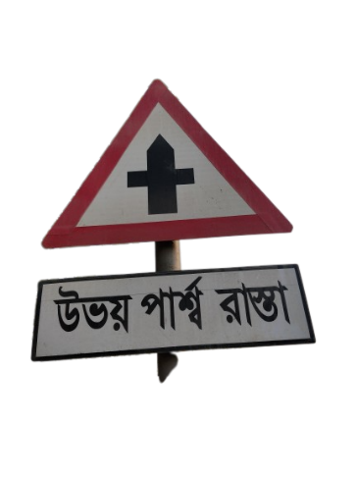
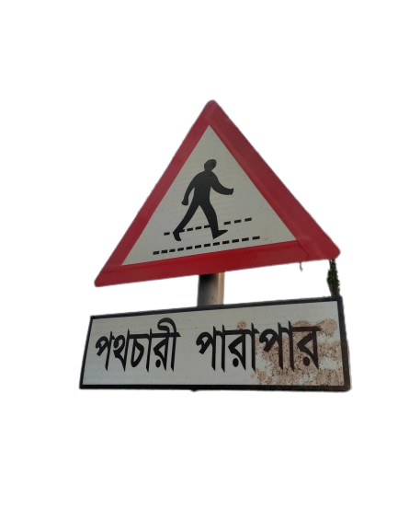
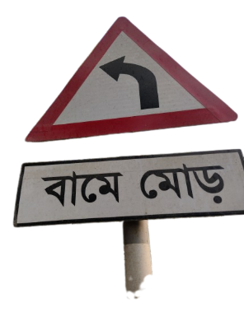
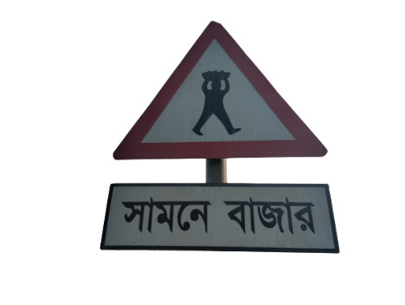
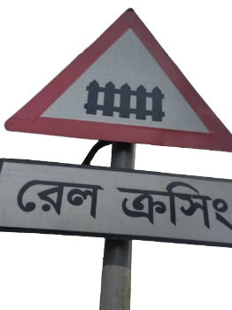
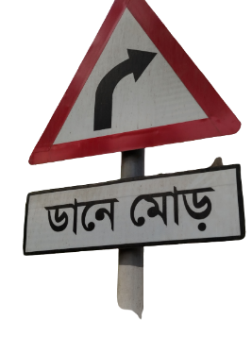
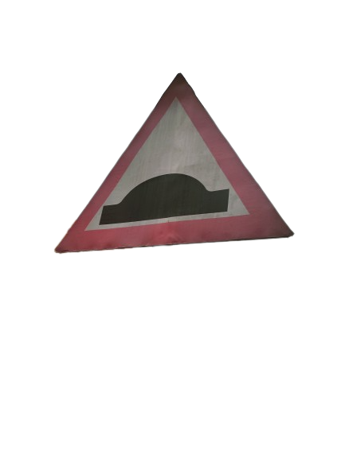
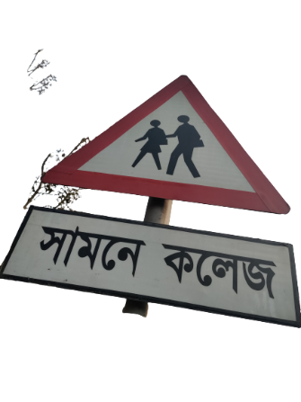

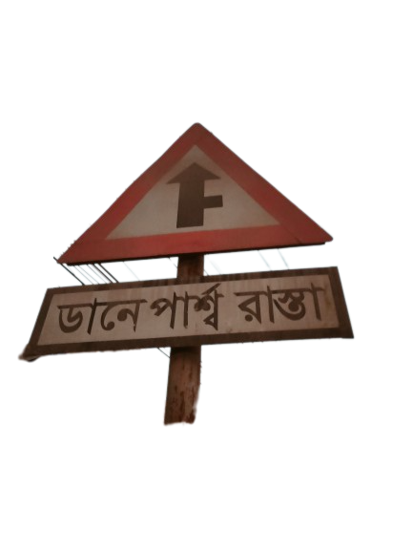
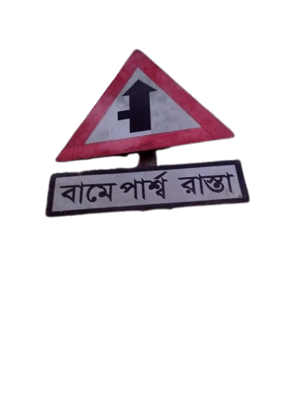
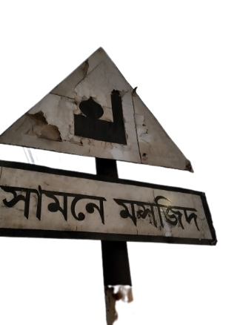
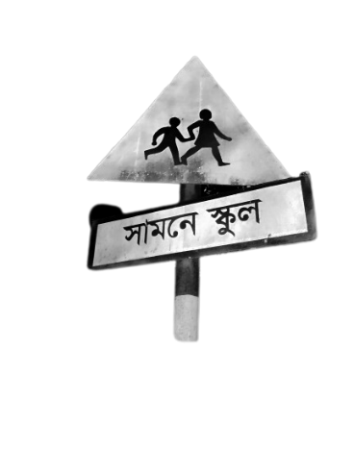
Dataset-1 Overview
Class Name:
Left turn
No of image: 658
Class Name:
Crossroad
No of image: 658
Class Name:
Market in front
No of image: 658
Class Name:
Right turn
No of image: 636
Class Name:
Pedestrian crossing No of image: 654
Class Name:
Rail crossing
No of image: 647
Class Name:
Speed breaker
No of image: 653
Class Name:
Side road left
No of image: 656
Class Name:
College in front
No of image: 657
Class Name:
Speed limit
No of image: 652
Class Name:
Mosque in front
No of image: 653
Class Name:
Side road right No of image: 660
Class Name:
School in front No of image: 644

Slide 8
Dataset-2 Overview
Class Name:
Left turn
No of image: 694
Class Name:
Crossroad
No of image: 682
Class Name:
Market in front
No of image: 693
Class Name:
Right turn
No of image: 692
Class Name:
Pedestrian crossing No of image: 687
Class Name:
Rail crossing
No of image: 690
Class Name:
Speed breaker
No of image: 689
Class Name:
Side road left
No of image: 682
Class Name:
College in front
No of image: 691
Class Name:
Speed limit
No of image: 696
Class Name:
Mosque in front
No of image: 699
Class Name:
Side road right
No of image: 692
Class Name:
School in front No of image: 683

Slide 9
Dataset-3 Overview
Class Name:
Left turn
No of image: 700
Class Name:
Crossroad
No of image: 715
Class Name:
Market in front
No of image: 710
Class Name:
Right turn
No of image: 715
Class Name:
Pedestrian crossing No of image: 720
Class Name:
Rail crossing
No of image: 720
Class Name:
Speed breaker
No of image: 715
Class Name:
Side road left
No of image: 705
Class Name:
College in front
No of image: 720
Class Name:
Speed limit
No of image: 710
Class Name:
Mosque in front
No of image: 715
Class Name:
Side road right No of image: 715
Class Name:
School in front No of image: 720

Slide 10
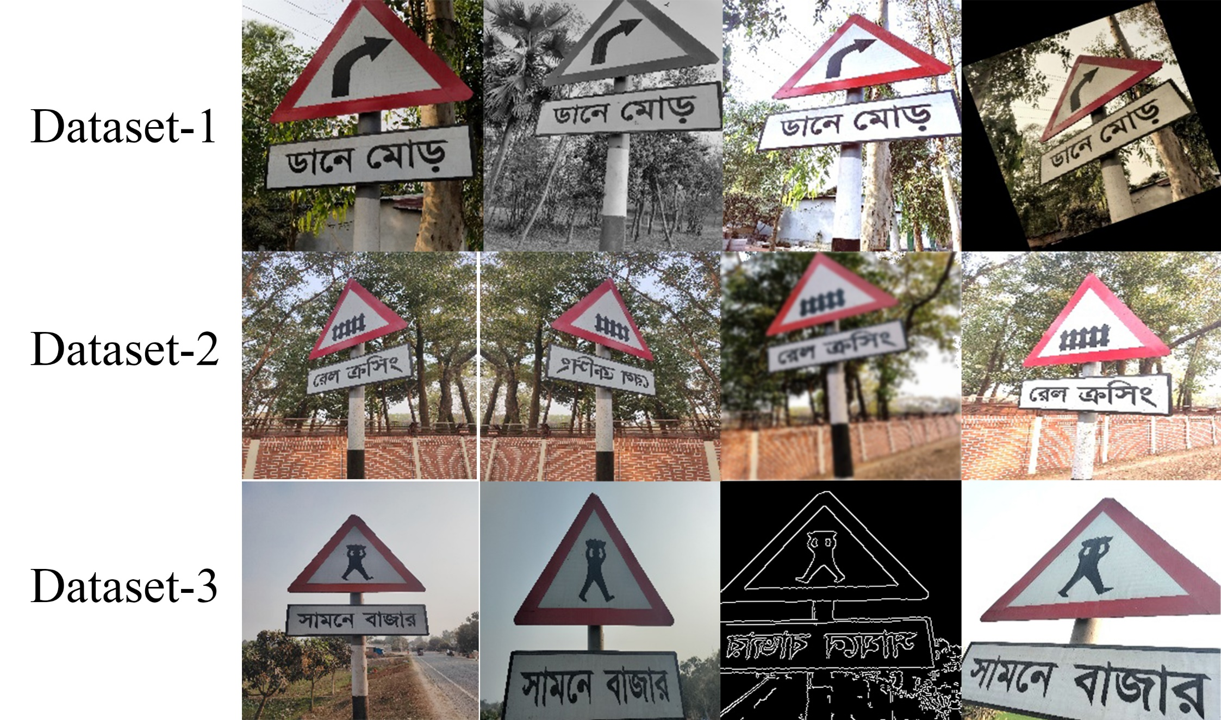
Sample images after applying data augmentation.

Slide 11
Environment setup
1
All experiments are conducted using TensorFlow version 2.11.0. The entire code is written and executed on the Google Colab platform.
2
CPU: Intel(R) Core(TM) i5-8265U CPU running at 1.60 GHz to 1.80 GHz
3
RAM: 8.00 GB
4
GPU: Google Colab (12 GB of GDDR5 memory and NVIDIA Tesla K80 GPU).

Slide 12
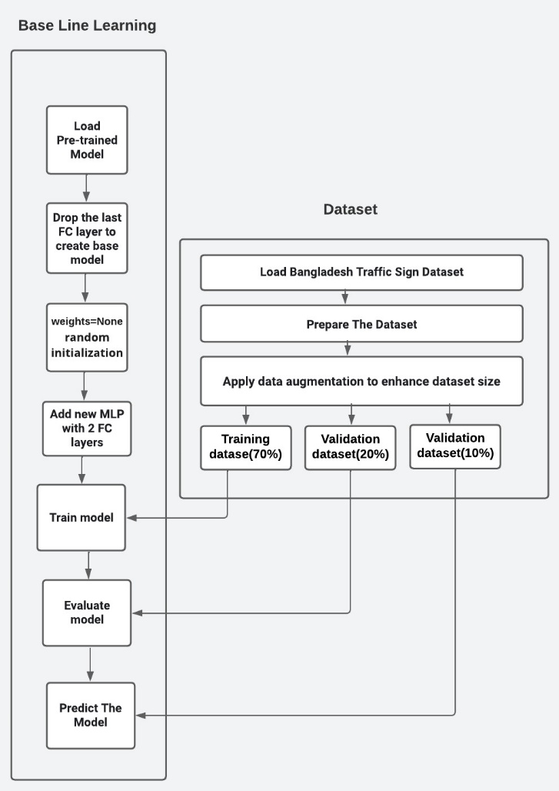
Flow Diagram for Base Line Training

Slide 13
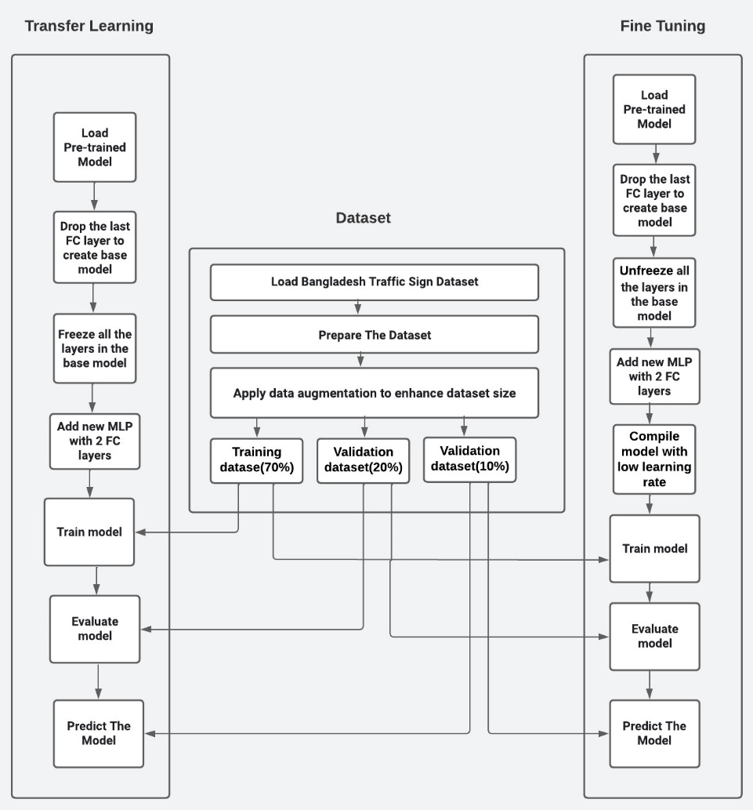
Flow Diagram for Transfer learning and fine-tuning

Slide 14
Name of model
Xception
DenseNet201
InceptionV3
Base Line Training
Base Line Training
Base Line Training
Transfer Learning
Transfer Learning
Transfer Learning
Fine-tuning
Fine-tuning
Fine-tuning
NASNetLarge
ViT
VGG19
ResNet101
EfficientNetB2
MobileNetV2
Transfer Learning
Transfer Learning
Transfer Learning
Transfer Learning
Transfer Learning
Transfer Learning
Fine-tuning
Fine-tuning
Fine-tuning
Fine-tuning
Fine-tuning
Fine-tuning

Slide 15
Traffic Sign dataset Experimental setup
Dataset: training(70%)
validation (20%)
testing(10%)
Image size = 224 * 224
Batch size of 32.
Image augmentation: Random flip, Random rotation, Random Translation, Random Zoom
loss= sparse categorical cross entropy
optimizer=Adam
learning rate = 1e-3

Slide 16
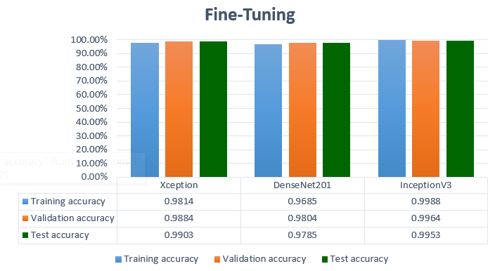
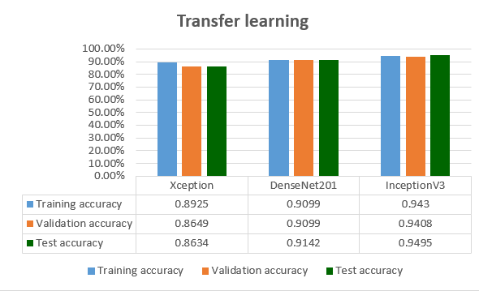
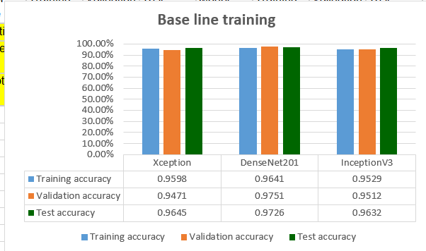
Result Analysis for Xception DenseNet201 InceptionV3 using Base line training, transfer learning and Fine-tuning

Slide 17
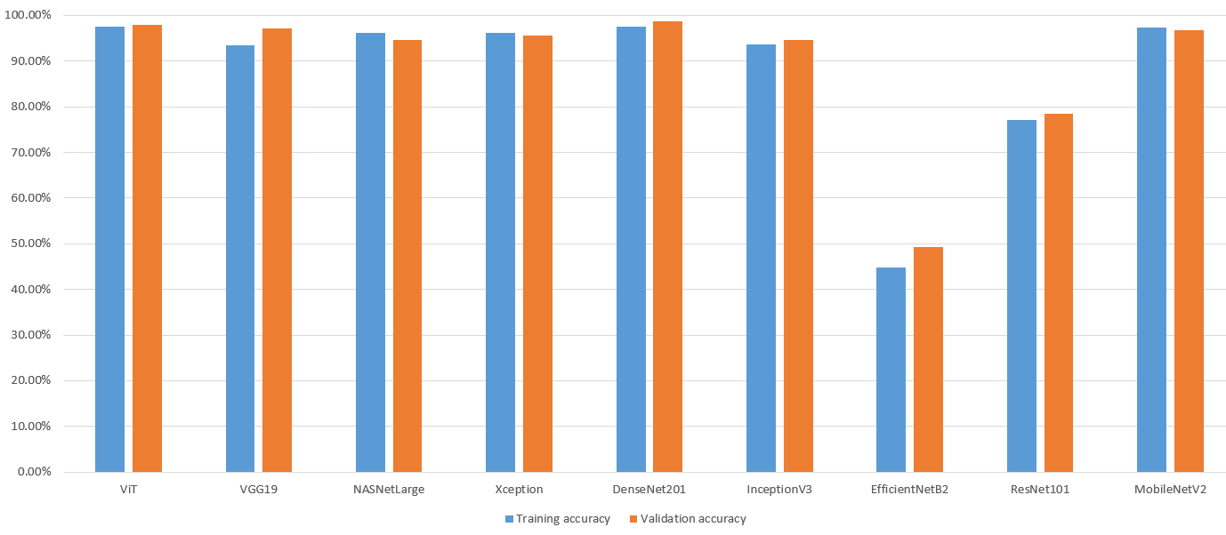
Result Analysis for All nine model using transfer learning

Slide 18
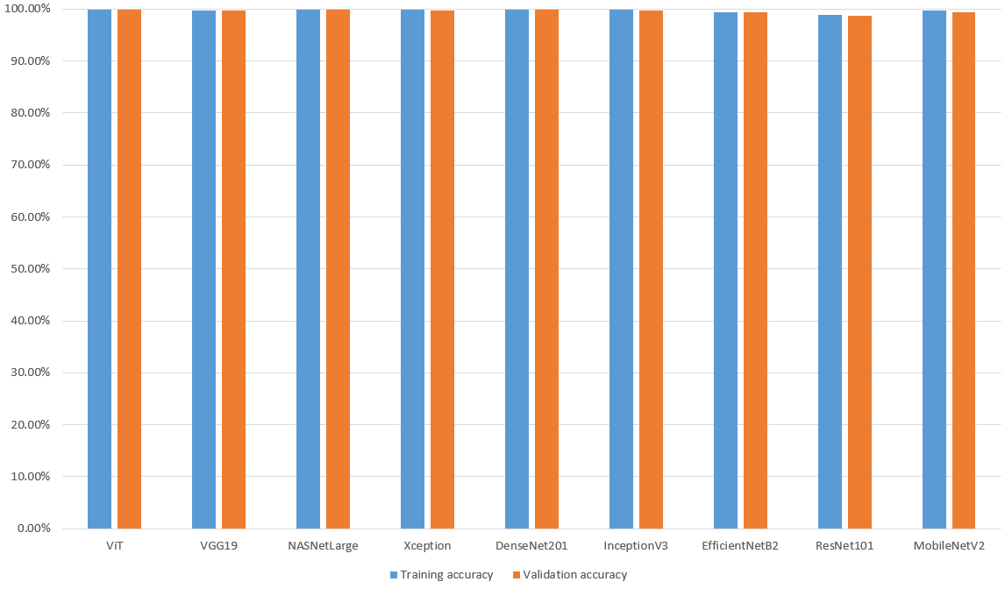
Result Analysis for All nine model using Fine tuning

Slide 19
Limitations
Limited dataset size and representativeness.
No exploration of integration with camera-based systems in real-time.
Limited hardware resources affecting speed and performance of models.

Slide 20
Future Recommendations
Expand database with more diverse real-world traffic sign images.
Explore and experiment with more deep learning models.
Develop a traffic sign recognition app for real-time assistance to drivers.

Slide 21
Conclusion
We summarizes the methodology and results of our project, which involved collecting a dataset of Bangladesh traffic signs, employing data augmentation and deep-learning models to recognize them, and achieving high validation accuracy using transfer learning and fine-tuning techniques.

Slide 22

Thank you everyone
Any Question?

